Slide 1
www.studybindas.com
Seminar
On
3D Printing
Submitted To: www.studybindas.com Submitted By: www.studybindas.com

Slide 2
Content
What is 3D printing?
General Principles
3D printing Methods
Applications
Challenges
Conclusion
Reference

Slide 3
What is 3D Printing?
For methods of applying a 2-D image on a 3-D surface
Additive manufacturing or 3D printing is a process of making a three-dimensional solid object of virtually any shape from a digital model. 3D printing is achieved using an additive process, where successive layers of material are laid down in different shapes.

Slide 4
What is 3D Printing?
Additive Manufacturing: The term additive manufacturing refers to technologies that create objects through a sequential layering process. Objects that are manufactured additively can be used anywhere throughout the product life cycle,

Slide 5
General Principles
Modeling
Printing
Finishing

Slide 6
Modeling
Additive manufacturing takes virtual blueprints from computer aided design (CAD) or animation modeling software and "slices" them into digital cross-sections for the machine to successively use as a guideline for printing.

Slide 7
Printing
To perform a print, the machine reads the design and lays down successive layers of liquid, powder, or sheet material to build the model from a series of cross sections.
These layers, which correspond to the virtual cross sections from the CAD model, are joined together or automatically fused to create the final shape.
The primary advantage of this technique is its ability to create almost any shape or geometric feature.

Slide 8
Finishing
Though the printer-produced resolution is sufficient for many applications, printing a slightly oversized version of the desired object in standard resolution, and then removing material with a higher-resolution subtractive process can achieve a higher-resolution.

Slide 9
Different Methods
Selective laser sintering (SLS)
Stereolithography
Fused deposition modeling (FDM)
Laminated object manufacturing

Slide 10
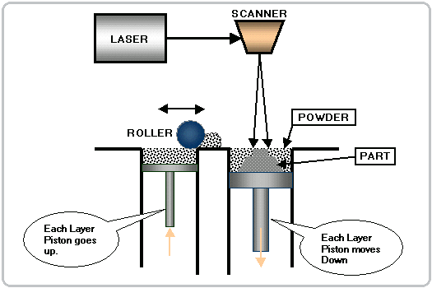
Selective laser sintering (SLS)
Selective laser sintering (SLS) is an additive manufacturing technique that uses a high power laser (for example, a carbon dioxide laser) to fuse small particles of plastic, metal (direct metal laser sintering),ceramic or glass powders into a mass that has a desired 3-dimensional shape

Slide 11
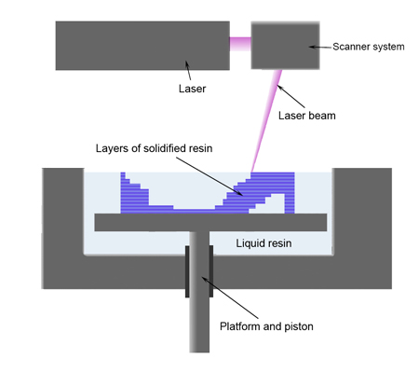
STEREOLITHOGRAPHY
Stereolithography is an additive manufacturing process using a vat of liquid UV-curable photopolymer ”resin” and a UV laser to build parts a layer at a time.

Slide 12
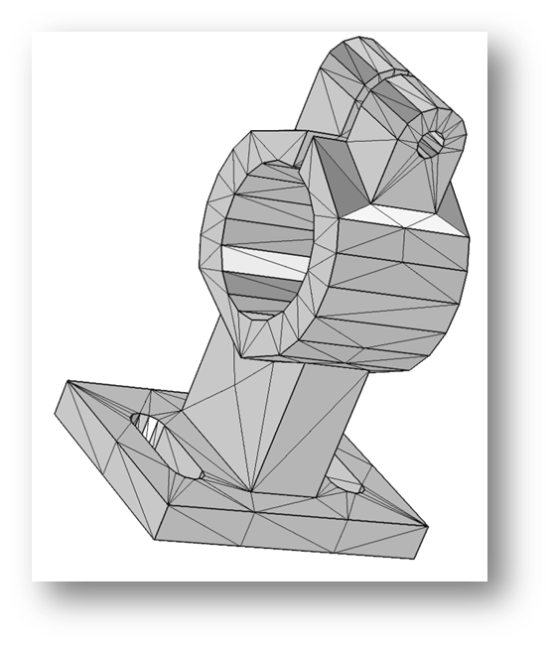
STEREOLITHOGRAPHY (Cont…)
CAD (Computer Assisted Design) Programs help users create STL Files for the 3D Printers to read.
STL (STereoLithography) file format – a file format which uses many little triangles to make a 3 dimensional plot of the objects intended surface.

Slide 13
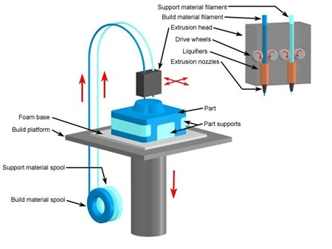
FDM
Fused deposition modeling (FDM) is an additive manufacturing technology commonly used for modeling, prototyping, and production applications

Slide 14
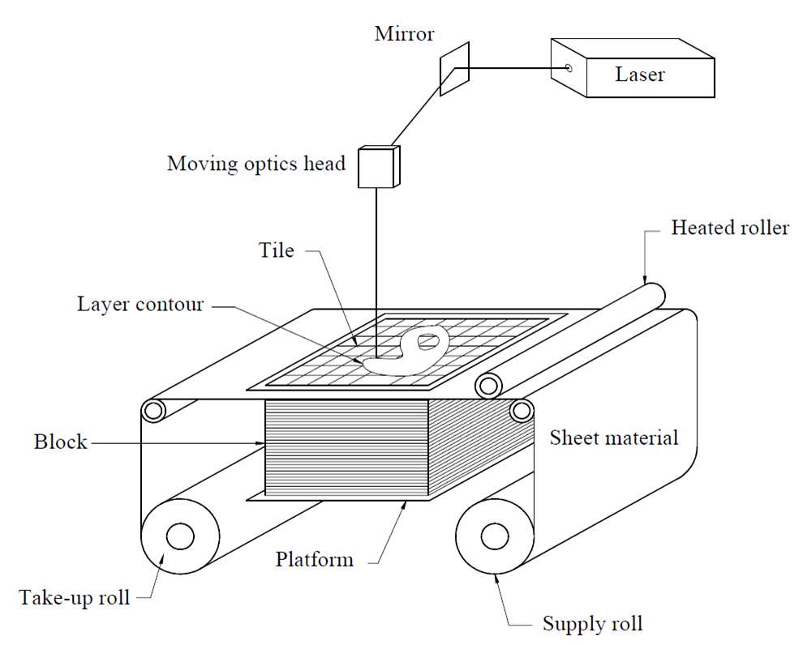
Laminated object manufacturing
Laminated object manufacturing (LOM) is a rapid prototyping system developed by Helisys Inc. In it, layers of adhesive-coated paper, plastic or metal laminates are successively glued together and cut to shape with a knife or laser cutter.

Slide 15
Applications
Prototyping
Modeling
Custom parts
Design
Research

Slide 16
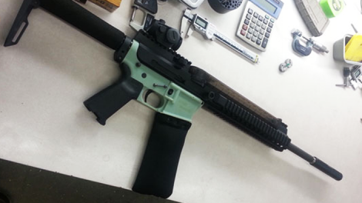
Challenges Facing 3D Printing
Intellectual property rights of the 3D Printer users.
Nearly anything can be printed by 3D Printers and this is a troubling prospect if criminals use 3D Printers to create illegal products.

Slide 17
Conclusion
Nothing communicates ideas faster than a three-dimensional part or model. With a 3D printer you can bring CAD files and design ideas to life – right from your desktop.
Test form, fit and function – and as many design variations as you like – with functional parts.

Slide 18
Reference
www.google.com
www.wikipedia.com
www.studybindas.com

Slide 19
Thanks

