Slide 1
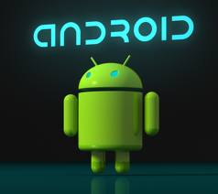
www.studybindas.com
Seminar On
Android
Submitted To: Submitted By:
www.studybindas.com www.studybindas.com
Notes:
1

Slide 2
Content
Introduction
What is Android
Advantages
Disadvantages
Applications
Architecture
Future
Conclusion
References

Slide 3
Introduction
Android is the first step in the vision of creating a better mobile phone. It is a complete open mobile platform software stack recently release by Google.
Android can be run on mobile devices from companies that have come together to form the Open Handset Alliance. The Alliance currently consists of 34 companies including Motorola, T-Mobile and Sprint-Nextel. These companies have agreed to open access devices.

Slide 4
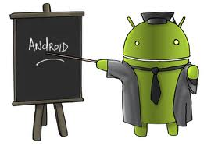
What is Android
Android is an operating system for Mobile phones. I will explain more about this in the later part of this article. Lot of advances can be seen these days in the field of smart phones.
As the number of users is increasing day by day, facilities are also increasing.

Slide 5
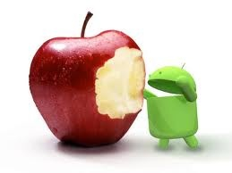
Advantages
Android can Run Multiple Apps at the Same Time.
Android keeps information visible on your home screen. Android has is a customizable home screen which keeps active widgets right at your fingertips, always accessible and always visible – without having to launch an application first.
Android has a better application market compare to Apple’s App because Apple’s App store has over 180,000 applications, while the Android Marketplace has only just broken the 50,000 mark.
Android gives you better notifications comparee to iPhone beacuse iPhone has some trouble with notifications. Because it’s restricted to pop-up notifications, it can only handle one at a time.
Android is Hardware independent.

Slide 6
Disadvantages
Connected to the Internet: Android can be said is in need of an active internet connection. At least there should be a GPRS internet connection in your area, so that the device is ready to go online to suit our needs.
Sometimes slow device company issued an official version of Android your own.
Android Market is less control of the manager, sometimes there are malware.
As direct service providers, users sometimes very difficult to connect with the Google.
Sometimes there are ads: because it is easy and free, sometimes often a lot of advertising. In appearance it does not interfere with the performance of the application itself, as it sometimes is in the top or bottom of the application.
Wasteful Batteries, This is because the OS is a lot of "process" in the background causing the battery quickly drains.

Slide 7
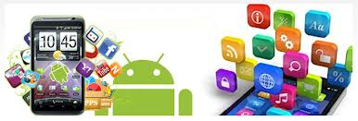
Applications in Android
Android initially came into existence with the sure fire idea that developments are given the power and freedom to create enthralling Mobile applications while taking advantage of everything that the mobile handset has to offer.
Android is built on open Linux Kernel. This particular software for Mobile Application is made to be open source, thereby giving the opportunity to the developers to introduce and incorporate any technological advancement. Build on custom virtual machine android gives its users the addition usage and application power, to initiate an interactive and efficient application and operational Software for your phone.
Google’s mobile operating device, the android is its awesome creation in the definitive creation of Software Applications for the mobile phone arena it also facilitates the g-juice in your mobile thus initiating a whole new world of Mobile Technology experience by its customers.

Slide 8
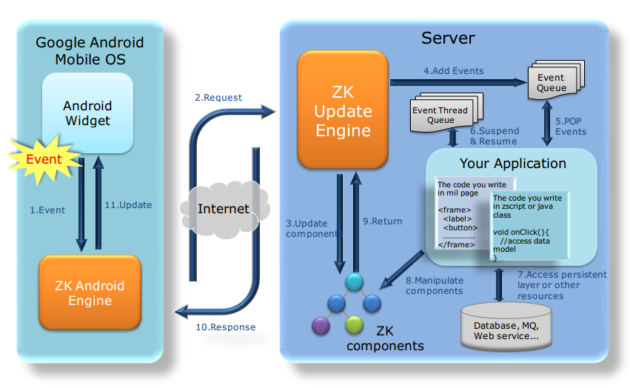
Architecture

Slide 9
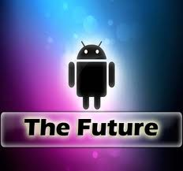
Future
I'm just curious to what you guys think the future of Android will be like, especially after Apple won their lawsuit with Samsung. With that lawsuit, and Adobe eliminating Mobile Flash, I am less optimistic about the future of Android than I have ever been.
The lawsuit could dramatically impact the design of Android (of course we will still have launchers to make our phone look how we want).
A future change in the basic design could dramatically hurt Android. The current Icon setup is the most popular for users (Windows, Macs, iPhone, Android) but if that were to change, people may not want to keep buying Androids.
Personally, I hope Samsung is able to sue Apple when the mini iPad comes out for design patents.

Slide 10
CONCLUSION
Android has been criticized for not being all open-source software despite what was announced by Google. Parts of the SDK are proprietary and closed source, and some believe this is so that Google can control the platform.
Software installed by end-users must be written in Java, and will not have access to lower level device APIs. This provides end-users with less control over their phone's functionality than other free and open source phone platforms, such as OpenMoko.

Slide 11
References
Hello, Android, E. Burnette, The Pragmatic Programmers (2009).
Professional Android 2 Application Development, R. Meier, Wiley (2010).
Beginning Android 2, M. Murphy, Apress (2010).
Android Wireless Application Development, S. Conder and L. Darcey, Addison-Wesley (2010).
Android Application Development in 24 Hours , L. Darcey and S. Conder, Sams (2010).
studybindas.com

Slide 12
Thanks

